Slide 1
Embedded Software Homework
Ekinoks Software

Slide 2
Task 1
UML Diagram

Slide 3
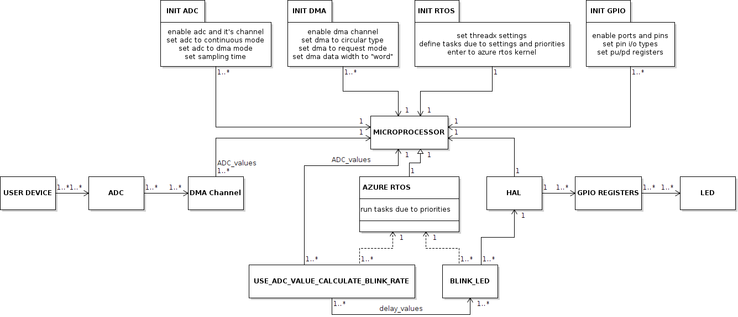
UML Diagram

Slide 4
Software Components & ADC and DMA
The software components we have are ADC, DMA, RTOS, HAL and microprocessor.
ADC stands for "Analog to Digital Converter" and is the unit for measuring analog signals.
he signal from the User Device is measured by the ADC and transferred to the microprocessor via DMA.

Slide 5
ADC and DMA Initializing
In order for the ADC to work together with the DMA, the settings of the ADC and the DMA must be made in the init function.
In the init function of the ADC, parameters such as the
number of channels to be used,
measurement accuracy,
measurement time,
clock bus to which it is connected
must be set.

Slide 6
ADC and DMA Initializing
In DMA's init function,
the channel used in DMA,
buffer properties,
circular or normal structure of DMA,
priority of data transfer process
are set.

Slide 7
GPIO Initializing & RTOS
On the other hand, in order to operate the LED, the Port and Pin that the LED is connected to must be activated and set as output in the GPIO Init function.
Since RTOS will be used, the tasks to be used in RTOS must be defined.
Thread 1: Use ADC Value to Calculate LED Blink Rate
Thread 2: Blink LED
After running the kernel, the data read from the ADC in one of these tasks should be processed mathematically and the blink rate should be calculated.

Slide 8
RTOS Tasks
After running the kernel, the data read from the ADC in one of these tasks should be processed mathematically and the blink rate should be calculated.
At this point, the sensitivity of the ADC is important for the maximum value it can take. (e.g.: 12 bit ADC’s maximum value = 2^12 - 1 = 4095)
The formula of blink time calculation:
Set Time = Blink Period * Read ADC Value / Maximum ADC Value
Reset Time = Blink Period * (1 - Read ADC Value / Maximum ADC Value)
In the other task, the function that makes LED Blink works.
HAL functions are used to make the LED blink. With these HAL functions we can control the GPIO registers.

Slide 9
Task 2
Controllable LED Blink in RTOS

Slide 10
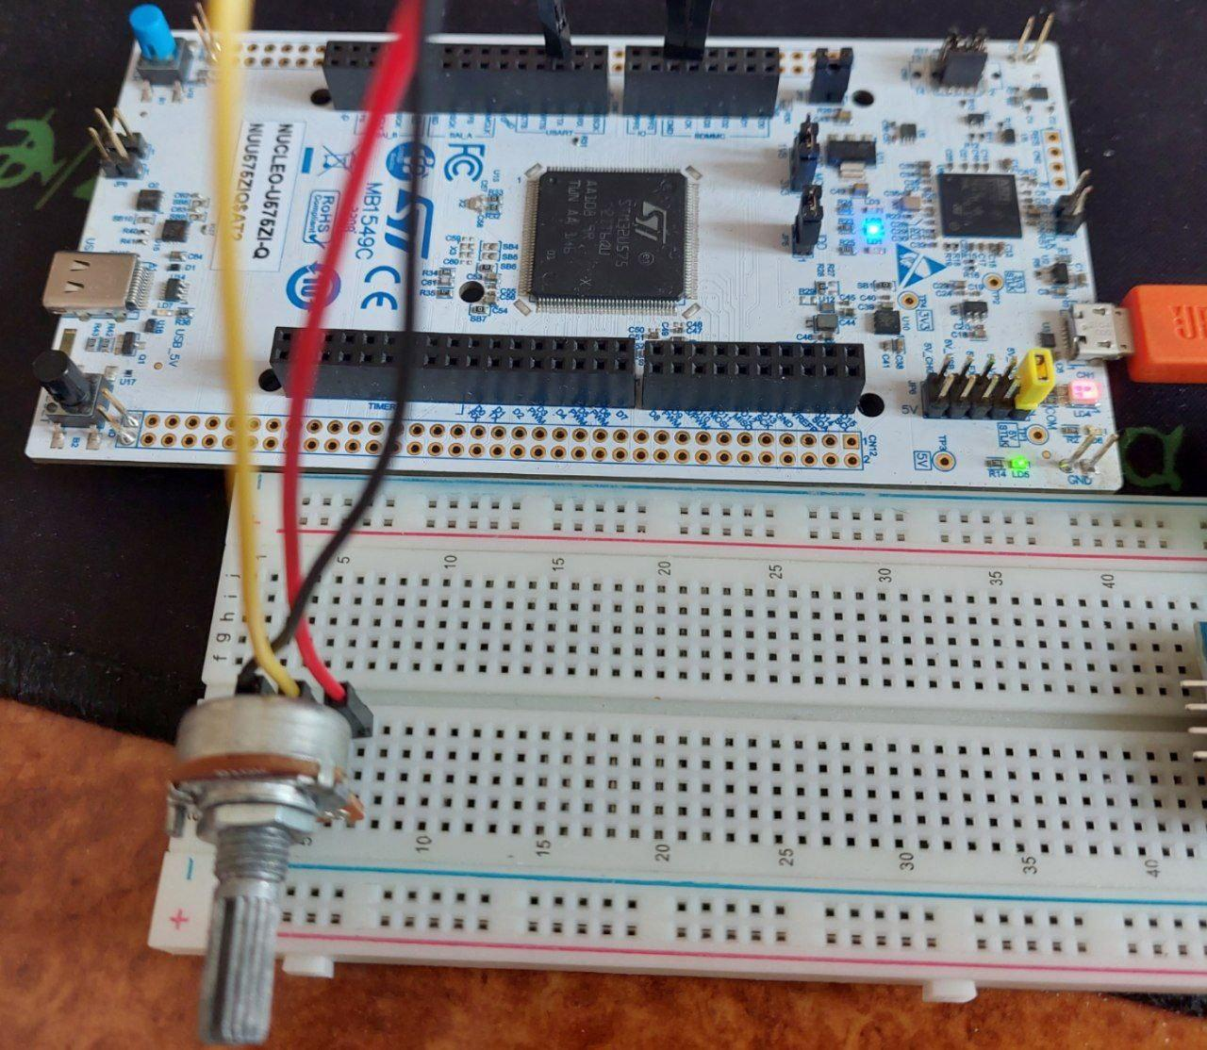
Hardware
In this project, I used STM32 Nucleo - U575ZI-Q as the development board, I used the blue LED on the development board for the LED to blink. I used a potentiometer as a user input device. You can find the circuit I built below:

Slide 11
Software
I chose ThreadX as RTOS, I explained why I chose it in the last assignment.
As the ADC, I chose the 4th input of the ADC4 channel.
I chose the 10th DMA channel as the DMA.
I do the development on the STM32Cube, so I made all the configurations on the STM32MX.

Slide 12
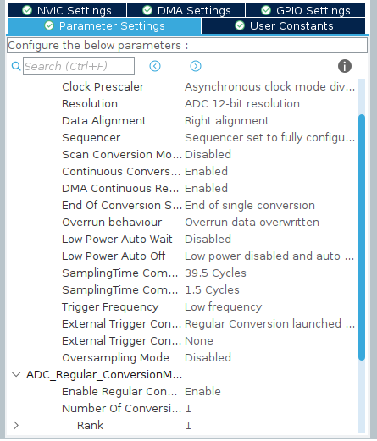
ADC Configuration
In order to make ADC measurement and transfer it to the microprocessor via DMA, we must first configure the ADC.

Slide 13
ADC Configuration
The important ones in this configuration are:
ADC's resolution = 12-bit, (to set ADC sensitivity)
Data alignment = Right Alignment, (to set ADC data storage direction)
Continious Conversion Mode = Enabled, (to be able to read ADC continuously)
DMA Continious Request = Enabled, (For ADC to work with DMA)
Sampling Time = 39.5 Cycles (to set the ADC read time)
Enable Regular Conversion = Enable (to be able to read ADC continuously)
Number of conversions = 1 (to set number of ADC inputs)
Rank = 1 (to set a specific ADC input)

Slide 14
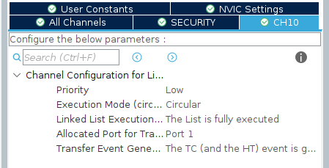
DMA Configuration
We should set up
Priority is Low,
DMA Execution is circular,
DMA type is Linked List
when configuring DMA.

Slide 15
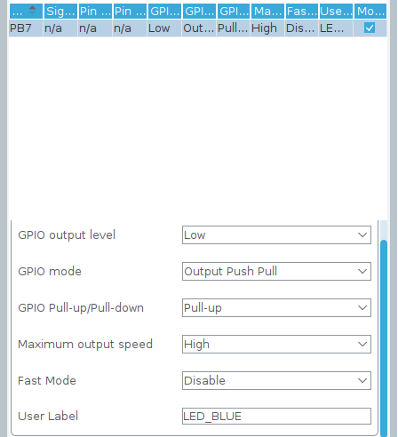
GPIO Configuration
We must configure the PB7 pin that the LED is connected to as "Output".

Slide 16

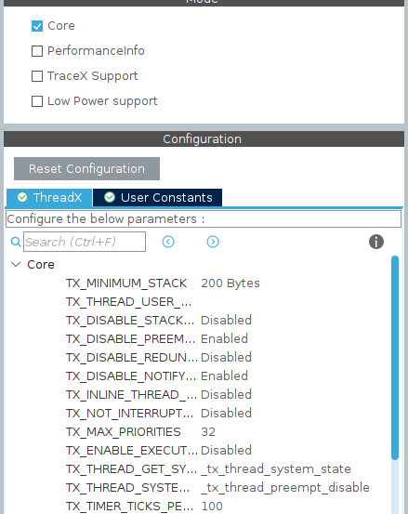
ThreadX Configuration
When we will use RTOS in microprocessor, we need to change Sys Time Base Source from SysTick to another Timer.
The important thing here is to select ThreadX Core, disable Preemption, and make a note of tx_timer_ticks_per_second.
That's it for the configuration settings. STM32CubeMX will generate a code with the configurations.

Slide 17
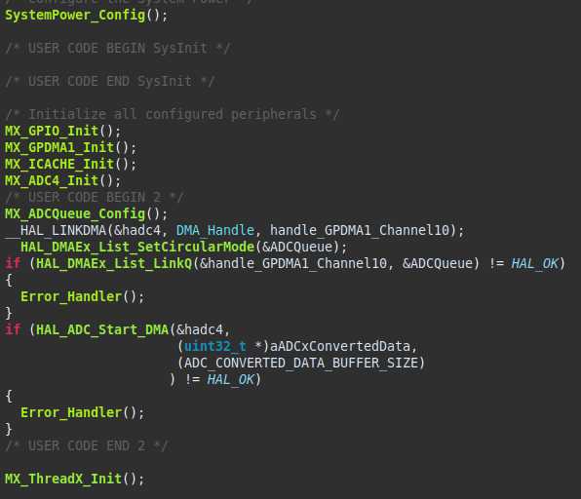
ADC on DMA

Slide 18
ADC on DMA
DMA channel is selected using __HAL_LINKDMA function, then DMA circular and linked list features are set and ADC DMA connection is established with HAL_ADC_Start_DMA function.

Slide 19

ThreadX
Functions that will run on RTOS should be developed in the app_threadx.c file.
Threads are started on App_ThreadX_Init and here the pointer addresses of the threads, thread name, thread function, thread stack, stack size, and priority are set.

Slide 20
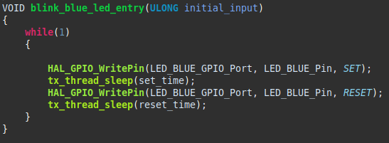
LED Blink Thread
In this thread, GPIO is set HIGH and LOW using HAL functions. set_time and reset_time are delay times from other thread.

Slide 21
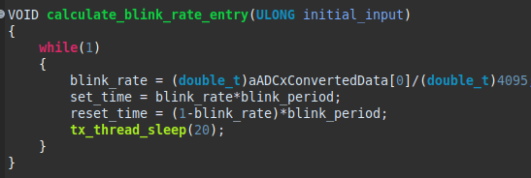
Calculating Blink Rate Thread
Here, the blink_rate is calculated by dividing the data read from the ADC and its maximum data. The time the LED stays on is the product of blink_period and blink_rate. reset_time is set_time's complement to blink_period.

Slide 22
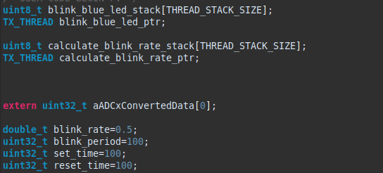
Note
When dividing the read ADC value and the maximum ADC value, we should use a "double" or "float" data type because we should get a "double" or "float" result from the operation we do. Otherwise we would have to multiply blink_period by 1 or 0.
In order to use the variable defined in the main.c file in the threadx file, it must be redefined by bringing “extern” in the threadx file.

Slide 23
Task 4
“INTER-INTEGRATED CIRCUIT”

Slide 24

What is I2C?
Inter-Integrated Circuit is is known as I2C.
I2C is a serial a synchronous communication protocol.
Invented in 1982 by Philips Semiconductors.

Slide 25
Common Applications of I2C
EEPROMs
Temperature Sensors
Accelerometers
Gyroscopes
LCD Displays
Audio Codecs
Digital Potentiometers

Slide 26
Advantages of I2C
Compared to other communication protocols, such as SPI and UART, I2C has several advantages:
It requires fewer wires, which reduces the complexity of the system.
Allows for multiple devices to be connected to the same bus, which can reduce the overall cost of the system.
Has built-in error detection and correction mechanisms, which make it more reliable than other protocols.

Slide 27
Physical Layer
There are 2 lines in physical layer:
Serial Data Line
Serial Clock Line
Serial Data Line is known as SDA.
Serial Clock Line is known as SCL.
These lines must be connected to the pull-up resistors.
Typically 5V, 3.3V or 1.8V used in this protocol.

Slide 28
Data Packet
The I2C generally has a 7 bit address space. Then, the last bit sets read or write.
ACK bit means “Active low for acknowledged”.
S | I2C address field |  |  |  |  |  |  | R/W’ | A | I2C message sequences |  | P
S T A R T | Byte 1 |  |  |  |  |  |  |  | A C K | Byte X etc… Rest of the read or write message goes here |  | S T O P
 | 7 | 6 | 5 | 4 | 3 | 2 | 1 | 0
 | M S B |  |  |  |  |  | L S B | 1 = Read
 |  |  |  |  |  |  |  | 0 = Write

Slide 29
Task 5
I2C SHT30

Slide 30
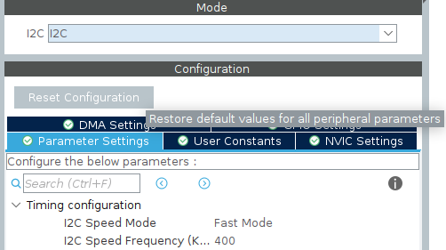
Configuration
We have to configure the GPIO that we reset the SHT30 sensor as output. Then, since we will use RTOS, we must install the System Timebase from Systick to any Timer. We have to set up the same configuration by selecting ThreadX Core as in the previous project.
After enabling I2C1,
we set I2C Speed Mode to fast mode and
set the I2C line frequency to 400KHz.

Slide 31
SHT30 library
We should implement the sht3x.h and sht3x.c files in the SHT30 HAL library in the link to our project.
Link: https://github.com/henriheimann/stm32-hal-sht3x

Slide 32
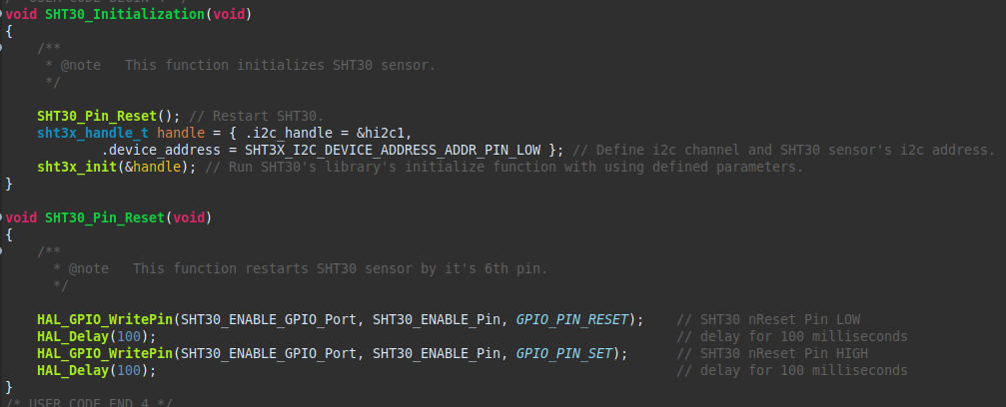
SHT30 Initializatiıon
I run my SHT30 sensor by running the SHT30_Pin_Reset and SHT30_Initialization functions I wrote in the main.c file before entering the ThreadX kernel.

Slide 33
ThreadX
In this function where I started the thread, I set the width of the stack as 1024 and the priority as 15, as in the previous project.

Slide 34
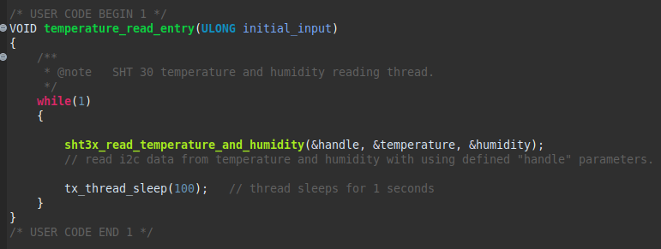
ThreadX
By using the i2c address and hal_i2c function defined in the library, the data from the sensor will be transferred to the address of the temperature and humidity variables.

Slide 35
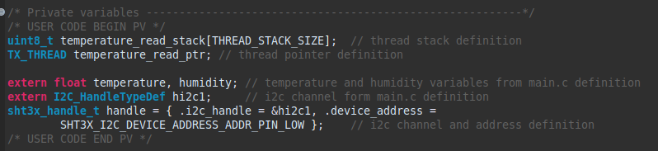
Notes
The handle dictionary structure holds the i2c channel and the i2c address of the sensor.

Slide 36
Task 6
Importance of Testing in Embedded Software Development

Slide 37
Essay
Testing is a very important part of developing software for embedded systems. Without testing, the software might not work properly, which could cause problems like the system crashing, performing slowly, or not working at all. This can be dangerous, especially if the system is meant to be used in a safety-critical environment.

Slide 38
Essay
To avoid these problems, developers need to follow certain guidelines when testing their software. They should define what they want to test and how they will test it, using tools that can help them do this more quickly and accurately. They should also test the software in different situations that simulate the real-world conditions it will be used in.

Slide 39
Essay
There are five levels of testing that can be done:
1- Software Unit Testing: This tests small parts of the software, like functions or classes, to make sure they work correctly. It is done by the developers and is usually reviewed by others.

Slide 40
Essay
2- Integration Testing: This tests how different parts of the software work together. It can be divided into software-only testing and testing that involves both software and hardware.

Slide 41
Essay
3- System Unit Testing: This tests the whole system, including the real-time operating system and other platform-related things. It is done by either the developer or a dedicated integration team.

Slide 42
Essay
4- System Integration Testing: The thing being tested starts with some parts in one place. There are some things called "Points of Control and Observations" that help check network related communication protocols and RTOS working together.

Slide 43
Essay
5- System Validation Testing: This tests the whole subsystem or the entire embedded system. The goal is to make sure it meets external requirements from people or devices.
Embedded software development can be challenging to test because the software's environment is often created at the same time as the software. This means testing must be done in real-world conditions, not just in a simulated environment. To make sure embedded software works well, it's important to test it thoroughly at each level and use different testing methods, like gray-box testing. By doing this, developers can be sure that the software works as intended and is safe for people to use.

Slide 44
Task 7
Bare Metal vs RTOS

Slide 45
Bare Metal vs RTOS
A bare-metal program is like a big loop that runs in sequence after initializing the hardware and software. Bare-metal programs are usually power-efficient, use less memory, and run faster than other programs. They work well for simple to average complexity applications that can run one sequential logic in a loop. But, complex applications can be hard to manage with only sequential logic. That's when using a real-time operating system (RTOS) can be helpful.

Slide 46
Azure RTOS ThreadX
Why did I choose Azure RTOS ThreadX?

Slide 47
Azure RTOS ThreadX Features
Small: 2 KBs footprint
Fast Performance
Safe, Secure: It has got Security Certificates. It passed tight pentests.
Easy to use: It has got consistent APIs and FreeRTOS middleware layer.

Slide 48
I have got NUCLEO-U575 development kit.
I am a user of STM32Cube programs. The STM32CubeMX program has the necessary package to provide Azure RTOS ThreadX configurations of the STM32U5 microprocessor.

Slide 49
Sources
https://www.guru99.com/embedded-software-testing.html
https://academy.nordicsemi.com/topic/bare-metal-vs-rtos-programming/
STMicroelectronics and Microsoft Azure’s Massive Open Online Courses
https://www.youtube.com/watch?v=eI5RA45OQGs
https://www.youtube.com/watch?v=Al7ngIoIHeQ&t=1s
https://www.youtube.com/watch?v=GDLeBBvOTmo
https://www.youtube.com/watch?v=oS3a7wn9P_s
Wikipedia

